Slide 1
Team: 1
Eventify
Updated Jira Kanban Board Sprint 2

Slide 2
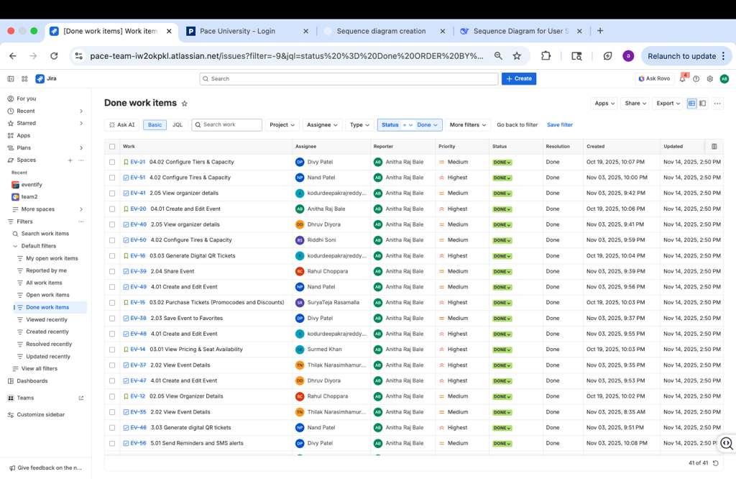

Slide 3
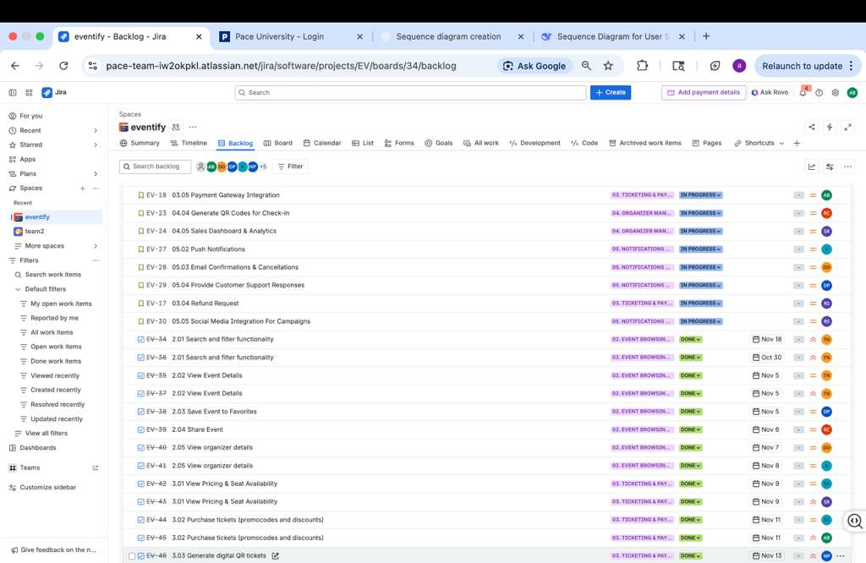

Slide 4
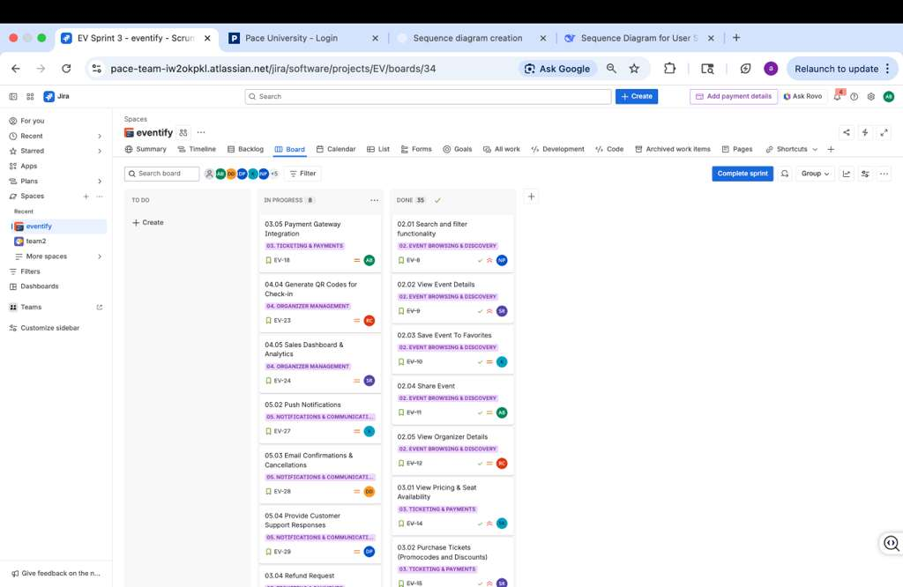

Slide 5
